Slide 1
RWEsearch & Health Innovation Hackathon-2025
Presented by:
Hetvi Vanzara (24bce513@nirmauni.ac.in)
Krish Marakana
Harsh Khanna
Urva Gandhi
Himanshu Mishra

Slide 2
Problem Statement
Your task is to develop an AI model that leverages CMS data to predict healthcare outcomes for Medicare and Medicaid beneficiaries, with a focus on patient health outcomes. The model should provide early insights into factors such as disease progression, hospital readmission rates, treatment costs, and treatment efficacy, enabling healthcare providers to deliver personalized interventions. You should focus only on chronic condition-related fields to identify the key factors that contribute to these outcomes and demonstrate how your solution can be used to improve patient care and system efficiency

Slide 3
Our Solution:
End-to-End Healthcare Analytics Pipeline
Integration of Beneficiary, Inpatient, Outpatient, and Prescription Data.
Feature Engineering on demographics, chronic flags, utilization (LOS, # admissions, costs).
Predictive Models: Ensemble (RF, GBM, XGBoost) + Deep Learning (NN with dropout, focal loss).
Clinical Insights Engine: Identifies top risk factors, cost impact, and comorbidity patterns.
Streamlit Dashboard: Interactive, professional, end-to-end analytics tool.
Outputs:
Early alerts for high-risk patients
Actionable recommendations for providers
Cost-saving scenarios for payers

Slide 4
Data Sources and Preparation:
Beneficiary Summary (2008–2010)
Age, Gender, Race, Coverage, Chronic conditions (SP_DIABETES, SP_CHF, SP_COPD, etc.).
Inpatient & Outpatient Claims
Admission/Discharge dates, Diagnosis codes, Payment amounts, LOS.
Prescription Drug Events (PDE)
Days supplied, refill adherence, drug costs.
Data Processing:
Merged across years, cleaned missing values, normalized cost & utilization.
Created readmission labels (30/60/90 days) by calculating gaps between admissions.
Handled class imbalance using weighted models.
Final dataset: Hundreds of thousands of rows, 100+ engineered features

Slide 5
Pipeline and Architecture
Step 1: Data Loading & Preprocessing
Read Beneficiary + Claims CSVs
Extract chronic flags, admission timelines, readmission labels
Step 2: Feature Engineering
Age, # admissions, Avg Length of Stay, Total inpatient cost
Top 20 ICD9 Diagnosis features
Chronic conditions mapped to binary flags
Step 3: Model Training
Ensemble Models: Logistic Regression, Random Forest, Gradient Boosting, XGBoost
Deep Learning NN (256-128-64-32) with BatchNorm, Dropout, Focal Loss

Slide 6
Step 4: Clinical Insights Generation
Top 10 risk factors (Random Forest feature importances)
Cost estimation model: Intervention vs No-intervention
Personalized treatment recommendation engine
Step 5: Visualization & Reporting
ROC curves, AUC comparisons, feature importance bar charts
Streamlit tabs for “Train Models”, “Patient Explorer”, “Costs & Recommendations”

Slide 7
Innovation and Uniqueness
Hybrid Modeling: Classical ML (RF, GBM, XGB) + DL → robust predictions across datasets.
Imbalance-Aware Training: Weighted losses, threshold tuning → improved recall for rare readmissions.
Threshold Optimization: Instead of the default 0.5, dynamic thresholds (0.3–0.7) are chosen for max F1 & Recall.
Clinical Insights Generator: Beyond predictions → identifies “why” (risk factors, comorbidities, chronic progression).
Cost Simulation: Converts predictions into USD savings potential with early interventions.
Streamlit Dashboard Design:
Modular tabs (EDA, Models, Costs, Explorer, Batch Predictions).
Professional UI (custom CSS, teal-accent branding, interactive Altair charts).
Patient-level analytics + system-level insights.

Slide 8
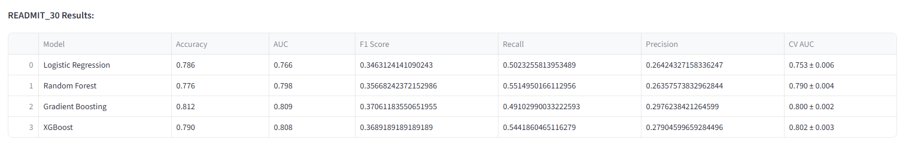
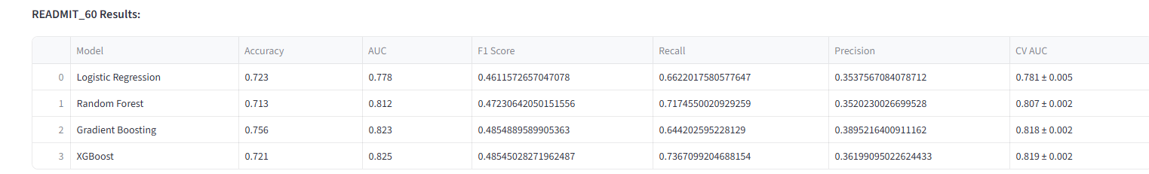
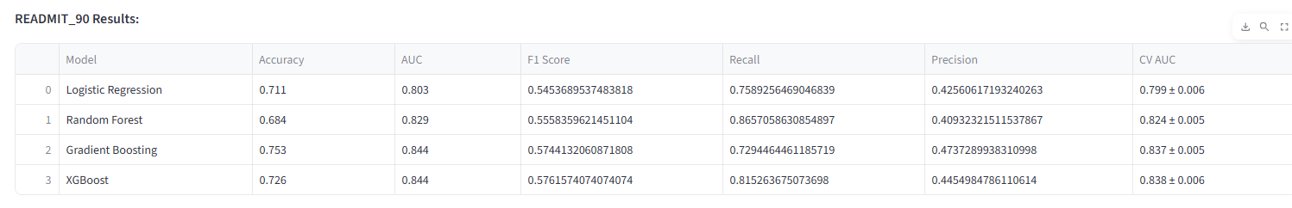
Model Results

Slide 9
Insights and Drivers
Top Risk Factors (Random Forest Importances):
Prior hospitalizations (# admissions)
Avg Length of Stay (LOS)
CHF, Diabetes, COPD flags
Inpatient costs
Age (elderly higher risk)
Disease Progression Tracker:
Rising prevalence: Diabetes, COPD over 2008–2010
Comorbidity hotspots: Diabetes + CHF, COPD + Depression
These insights guide early patient segmentation for intervention.

Slide 10
Cost Impact Analysis
Without intervention:
High-risk readmission cost ~$20,000 per patient
With preventive intervention:
Preventive care ~$2,000/patient
Significant reduction in readmission probability
Potential Savings (30-day horizon): Millions annually across CMS population.
Example (pipeline output):
High-risk patients flagged: 2,300
Intervention Savings: ~$28M

Slide 11
Personalized Recommendations
High Risk
Daily case management
Medication adherence monitoring
Telehealth check-ins & 48-hr post-discharge follow-up
Medium Risk
Bi-weekly telehealth check-ins
Disease-specific education programs
7-day follow-up post-discharge
Low Risk
Preventive care reminders
Nurse hotline access
Monthly wellness checks
Ensures right care, right patient, right time.

Slide 12
Streamlit Dashboard Demo
Key Features:
Upload & Prepare Tab: Upload raw CMS CSVs / local paths.
Data Overview Tab: Summary stats, readmission counts, demographics, chronic prevalence.
Train Models Tab: One-click training of all models (30/60/90).
Performance & ROC Tabs: Compare model metrics visually.
Costs & Recommendations Tab: $ impact + patient risk-tier care suggestions.
Disease Progression Tab: Trends in chronic prevalence & comorbidities.
Patient Explorer: Drill into individual patient profiles.
Batch Predictions: Upload CSVs for bulk inference.

Slide 13
Impact
Providers: Early warnings for at-risk patients → targeted care.
Payers (CMS/Medicaid/Insurers): Cost savings from reduced readmissions.
Patients: Better quality of care & outcomes.
System: Scalable solution → extendable to other datasets (EHRs, private insurance).
Innovation: Bridges real-world evidence (RWE) to real-world action.

Slide 14
Future Roadmap
Integrate with real-time EHR systems.
Expand to treatment efficacy & survival analysis.
Scale pipeline to multi-modal healthcare data (lab, imaging).
Deploy on cloud-native platforms (AWS/GCP/Azure) for hospital adoption.
Enhance dashboard → plug-and-play tool for hospital administrators & policymakers.

Slide 15
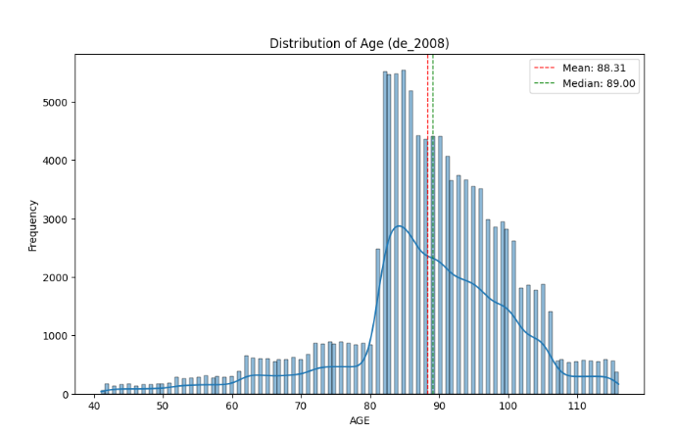
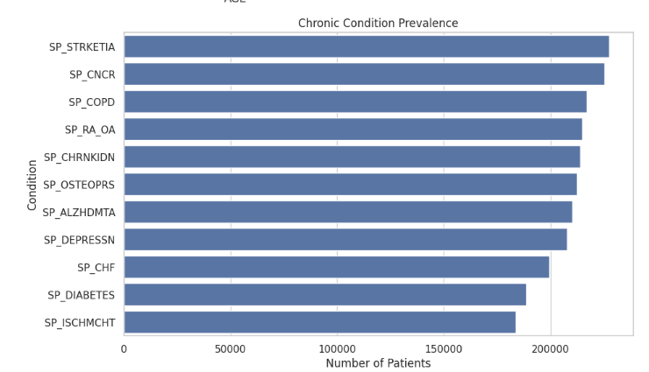
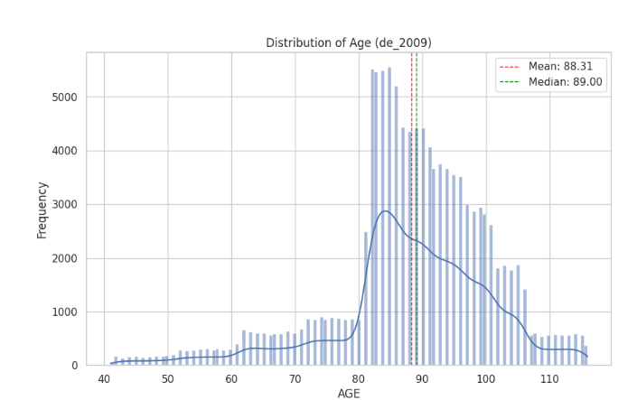
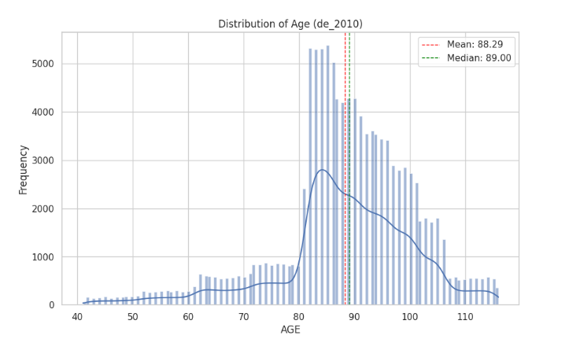
Data Visualization

Slide 16
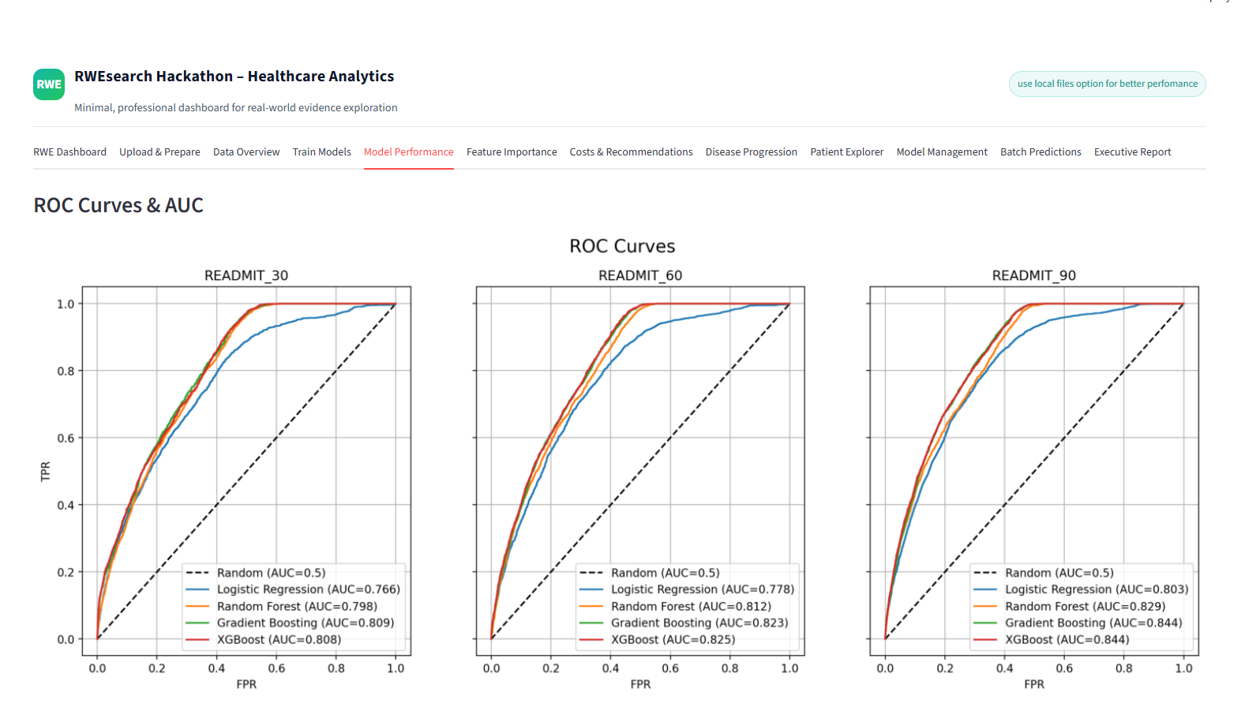
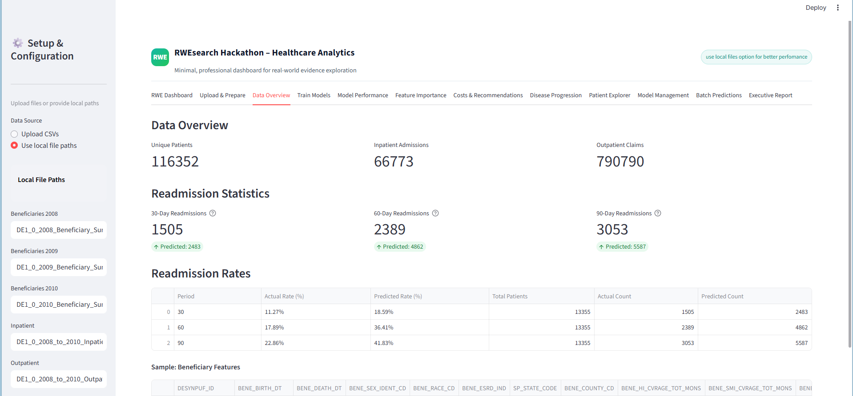
DashBoard Visualization

Slide 17
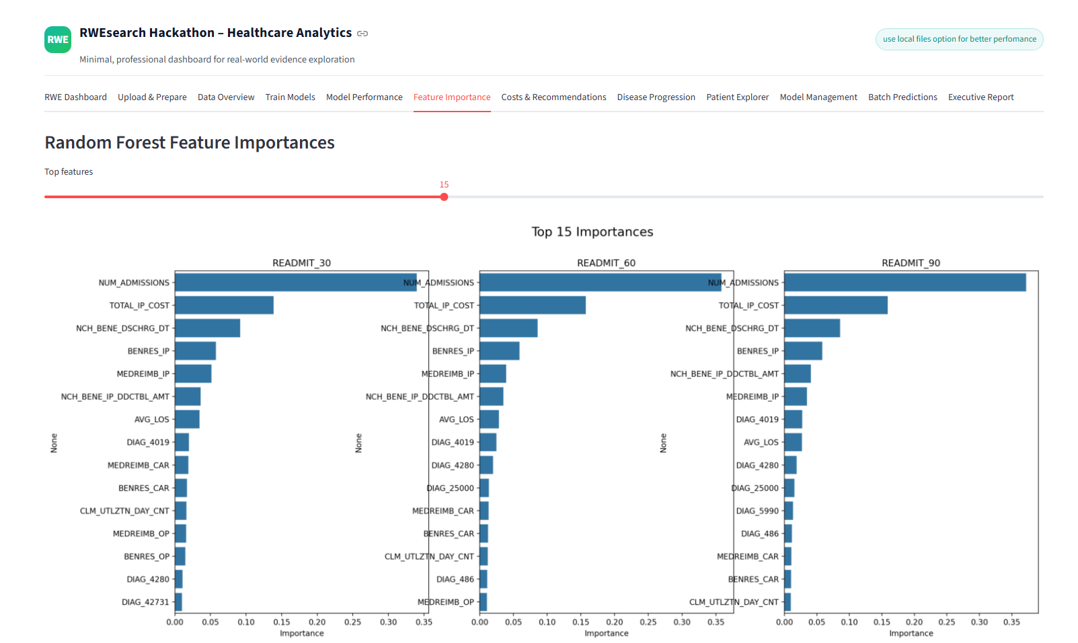
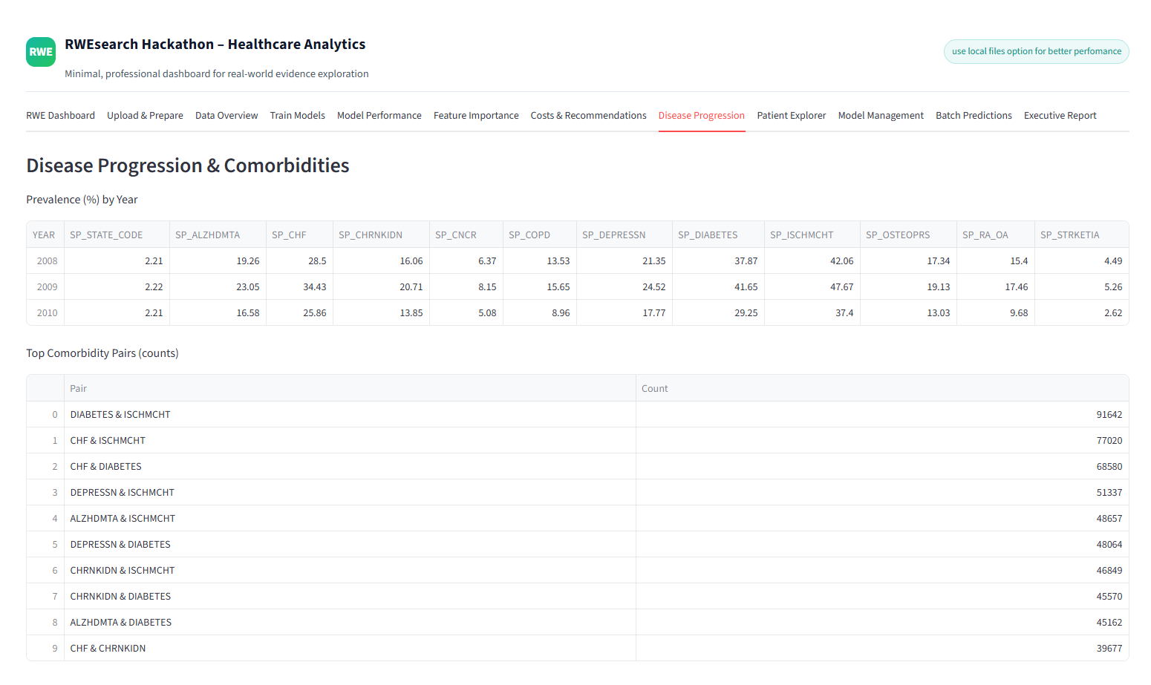
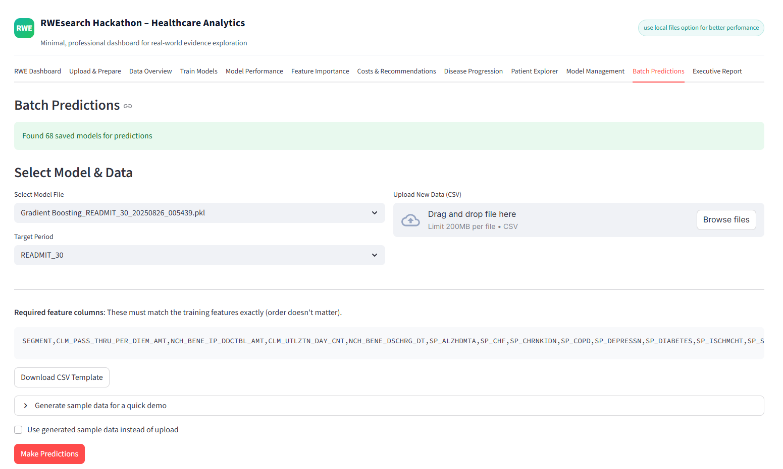

Slide 18
Closing and Takeaways
Transforming Real-World Evidence into Real-World Impact
End-to-End Solution From raw CMS claims → predictive models → actionable insights
Innovation Beyond Prediction Hybrid AI models + cost simulation + clinical recommendations
Real-World Value
Patients → Better outcomes & personalized care
Providers → Early alerts for timely interventions
Payers → Significant cost savings by reducing readmissions
System → Scalable, adaptable pipeline for chronic disease management
Our Contribution at RWEsearch Hackathon 2025
Built an end-to-end pipeline from raw CMS data → insights.
Combined AI, ML, and DL models for accurate readmission predictions.
Designed a Streamlit dashboard for transparency & usability.
Delivered clinical insights + cost recommendations → not just predictions.

Slide 19
Thank You

